Slide 1
Arithmetic Algorithms and ALU Design
Mainak Chaudhuri
Indian Institute of Technology Kanpur

Slide 2
Sketch
Abstract model of computer
ALU architecture
Arithmetic algorithms
Overflow detection in addition and subtraction
Integer multiplication
Integer division
Floating-point addition
Floating-point multiplication

Slide 3
Abstract model of computer
Computer has an ISA
The implementation of the ISA is an abstract five-state synchronous FSM
Each state change happens on posedge clock
State 0: fetch the instruction pointed to by program counter from memory; update program counter to point to the next instruction
State 1: decode the instruction to extract various fields and read source register operands
State 2: execute the instruction in ALU; compute address of load/store instructions; update program counter if control transfer instruction
State 3: access memory if load/store instruction
State 4: write result to destination register if the instruction produces a result

Slide 4
Abstract model of computer
Fetching an instruction requires accessing memory with the program counter as addr.
Decoding an instruction for MIPS is simple due to small number of formats and fixed position of the register specifiers
Reading operands from register file requires exercising the read ports
Executing an instruction and computing address of a load/store instruction requires an arithmetic logic unit (ALU)
Load/store instructions access memory with the computed address
Writing result to register file requires exercising the write ports

Slide 5
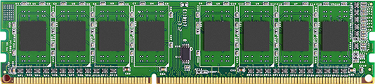
Abstract model of computer
The logic on processor chip implements the FSM and the ALU
Processor chip
(SRAM + logic)
I/O
Devices
DRAM controller
DRAM channels

Slide 6

Abstract model of computer
FSM + ALU
Processor logic
DIMM card
32-bit
address
bus
Command
bus (read/
write)
ACT/
PRE/CAS
64-bit
data
ch.
32-bit
data
bus
Addr.
bus
64-byte data bus
SRAM cache
DRAM
Controller
32-bit addr. bus
Command bus
Read/Write

Slide 7
ALU architecture
ALU is responsible for executing the core of the MIPS instructions
Everything except load/store instructions
ALU takes two inputs for most instructions and produces a result that may or may not get written to a destination register
For example, control transfer instructions do not write to a general-purpose register, but writes to the program counter
ALUs are of two kinds: integer and floating-point
The floating-point ALU is often referred to as the floating-point unit (FPU)

Slide 8
Integer ALU architecture
Components of the integer ALU
Adder/subtractor
Executes add, addu, sub, subu, addi, addiu
Computes target of conditional branch instructions
Computes address of load/store instructions
Multiplier
Executes mult, multu
Divider
Executes div, divu
Logic gate array
Executes and, nor, or, xor, andi, ori, xori, lui
Comparator and branch subunit
Executes slt, sltu, slti, sltiu
Executes the comparison part of beq, bne, bgez, bgtz, bltz, blez

Slide 9
Integer ALU architecture
Components of the integer ALU
Shifter
Executes sll, sllv, sra, srav, srl, srlv
Naïve implementation would shift by one bit position in every clock cycle
Inefficient for arbitrary shift amounts
Barrel shifters can shift an operand by arbitrary amount in time no more than an addition takes
Multiplexer (part of branch subunit)
Selects between branch target and PC+4 depending on the output of the comparison part of cond. branch
Data movement unit (part of multiplier/divider)
Executes mflo, mfhi, mtlo, mthi
Some designs do not consider the shifter, multiplier, and divider as part of the ALU

Slide 10
Overflow detection in MIPS
MIPS ISA offers two types of arithmetic instructions for addition and subtraction
One type detects overflows (add, sub, addi) and the other doesn’t (addu, subu, addiu)
Whether overflow should be detected in arithmetic operations is a part of the HLL specification
MIPS ISA can support both types of HLLs
If add/sub overflow is supposed to be detected, MIPS raises an exception on arithmetic overflow
Saves PC in EPC
Saves all general-purpose and floating-point registers in memory
Jumps to a fixed handler which examines cause and status registers to invoke the appropriate exception handler

Slide 11
Overflow detection in MIPS
Arithmetic overflow exception
On completion of the handler
Restore all general-purpose and floating-point registers from memory
Compute EPC+4 and move it to $k0 or $k1 (same as $26 and $27)
These two registers are reserved for use of operating system (e.g., interrupt, exception, system call handlers)
These two registers are not preserved across handlers
Execute jr $k0 or jr $k1 depending on where EPC+4 is
Overflow detection is also possible in software
Not very relevant for MIPS addition/subtraction
Important for processors that cannot detect overflow in hardware

Slide 12
Overflow detection in software
Software cannot access the carry bits into and out of the most significant bit position
So, cannot compare these to detect overflow
Observation
In signed addition, an overflow is detected if and only if the operands have the same sign and the result has sign opposite of the operand
If the operands have opposite signs, the result is guaranteed to have smaller magnitude than the larger magnitude operand and hence, there cannot be an overflow
In signed subtraction, an overflow is detected if and only if the operands have opposite signs and the result has sign opposite of the first operand
If the operands have the same sign, the result is guaranteed to have smaller magnitude than the larger magnitude operand

Slide 13
Overflow detection in software
Code for detecting overflow in signed addition ($t0 = $t1 + $t2)
addu $t0, $t1, $t2 # no overflow exception
xor $t3, $t1, $t2
slt $t3, $t3, $0 # $t3 is 1 iff signs of $t1, $t2 differ
bne $t3, $0, no_overflow
xor $t3, $t0, $t1
slt $t3, $t3, $0 # $t3 is 1 iff signs of $t0, $t1 differ
bne $t3, $0, overflow_handler
no_overflow: …

Slide 14
Overflow detection in software
Unsigned addition and subtraction
Overflow is detected if and only if the magnitude of the result exceeds the maximum representable unsigned value
2³² – 1 for 32-bit processors
Code for detecting overflow in unsigned addition ($t0 = $t1 + $t2)
addu $t0, $t1, $t2 # no overflow exception
nor $t3, $t1, $0 # $t3 has 2³² - $t1 – 1
sltu $t3, $t3, $t2 # $t3 has 1 iff $t1 + $t2 > 2³² – 1
bne $t3, $0, overflow_handler
Note that the comparison must be unsigned (sltu) so that 2³² - $t1 – 1 and $t2 are treated as unsigned operands

Slide 15
Multiplication algorithm
One operand is called the multiplicand and the other is called the multiplier
m-bit multiplicand and n-bit multiplier lead to (m+n)-bit product
Paper-pencil algorithm (assume unsigned operands)
1001 multiplicand
x 1010 multiplier
---------------------------------------------------------------
0000
1001 (why shift left?)
0000
1001
---------------------------------------------------------------
1011010

Slide 16
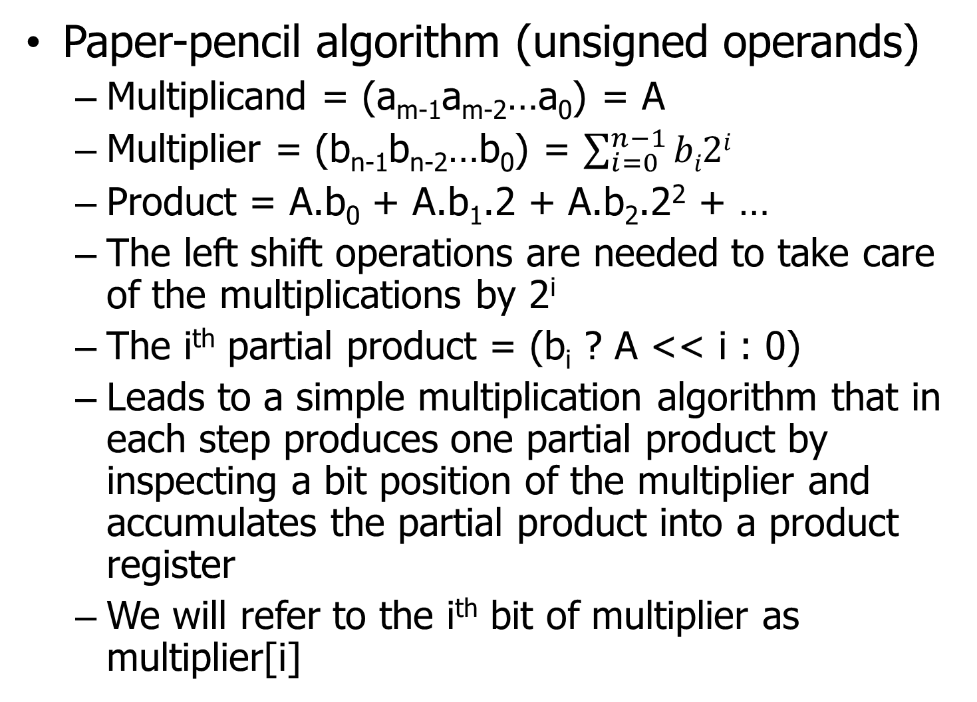
Multiplication algorithm
Paper-pencil algorithm (unsigned operands)
Multiplicand = (a_{m-1}a_{m-2}…a₀) = A
Multiplier = (b_{n-1}b_{n-2}…b₀) = $\sum_{i=0}^{n−1}{bi2i}$
Product = A.b₀ + A.b₁.2 + A.b₂.2² + …
The left shift operations are needed to take care of the multiplications by 2^{i}
The i^{th} partial product = (b_{i} ? A << i : 0)
Leads to a simple multiplication algorithm that in each step produces one partial product by inspecting a bit position of the multiplier and accumulates the partial product into a product register
We will refer to the i^{th} bit of multiplier as multiplier[i]

Slide 17
Multiplication algorithm
N
Multiplier[0] == 0 ?
Y
N
Product ← Product + Multiplicand
Shift_amount == n ?
Y
Multiplicand ← Multiplicand << 1
STOP
Multiplicand [m-1:0]
Multiplier [n-1:0]
Product [m+n-1:0]
Initial:
Product ← 0
Shift_amount ← 0
Multiplier ← Multiplier >> 1
Shift_amount++

Slide 18
Multiplication algorithm
Clock inputs
(m+n)-bit multiplicand register
<< 1
(m+n)-bit adder
n-bit multiplier register
>> 1
LSB
(m+n)-bit product register
AND
Latency: n clk cycles
Clock cycle time =
max (adder, shifter,
incrementer latency)
log n-bit shift amount
+1
n
!= ?
AND
clk

Slide 19
Multiplication algorithm (simpler)
Clock inputs
m-bit multiplicand register
m’b0
m-bit adder
Cout
MUX
m+n-1:n
m+n-1:n
(m+n)-bit {product,multiplier} register
>> 1
LSB
log n-bit shift amount
+1
n
!= ?
AND
clk

Slide 20
Faster multiplication
In the basic algorithm, n additions are done sequentially because we have used only one adder
Consider the following grouping
Product = (A.b₀+A.b₁.2) + (A.b₂.2²+A.b₃.2³) + (A.b₄.2⁴+A.b₅.2⁵) + …
The additions in the parentheses can be done in parallel after appropriately shifting the multiplicand (requires n/2 adders)
The results of these n/2 additions can be further paired and combined in n/4 adders
Overall, n – 1 additions would be arranged in a binary tree and the multiplication requires log₂n cycles (can be done with n/2 adders)

Slide 21
Signed multiplication
Negate the negative operands and do the multiplication
If the signs of the operands are opposite, negate the multiplication result
MIPS has both signed and unsigned multiplication
mult instruction treats operands as signed
multu treats operands as unsigned
MIPS offers no hardware support for detecting overflow in multiplication
If needed, must be done in software

Slide 22
Booth’s multiplication algorithm
Due to Andrew Booth [1951]
Handles both unsigned and signed operands
Basic observation
Let the multiplicand be A and let the multiplier be b_{n-1}b_{n-2}…b₀ = 000…011…100…0 where the block 1’s ranges from b_{p} to b_{q} with p < q
Therefore, the multiplier is 2^{q+1} – 2^{p} and the product is (A << (q+1)) – (A << p)
Can be generalized by representing the multiplier as addition of disjoint blocks of 1’s
Append b₋₁ = 0 at the end of the multiplier
Assume that both multiplicand and multiplier are in two’s complement representation

Slide 23
Booth’s multiplication algorithm
Algorithm
Initialize product register to 0
Scan the multiplier from b₀ to b_{n-1}
When examining b_{i}, if b_{i} == b_{i-1}, keep scanning
When examining b_{i}, if b_{i} is 1 and b_{i-1} is 0, subtract (A << i) from product register
When examining b_{i}, if b_{i} is 0 and b_{i-1} is 1, add (A << i) to the product register
If i==n – 1, stop. Final product is in two’s complement representation.

Slide 24
Booth’s multiplication algorithm
Observations
In the worst case, needs n addition operations when the multiplier has an alternating bit pattern i.e., 0101…01
If b_{n-1} is 1 (negative multiplier), the last operation done on the product would be a subtraction
Will result in a positive product, if the multiplicand is also negative; otherwise the product is negative
Booth’s algorithm can be implemented in two stages
First stage scans the multiplier and prepares the addition/subtraction operands
Second stage does the additions and subtractions in a binary tree of adders as in the fast multiplication algorithm

Slide 25
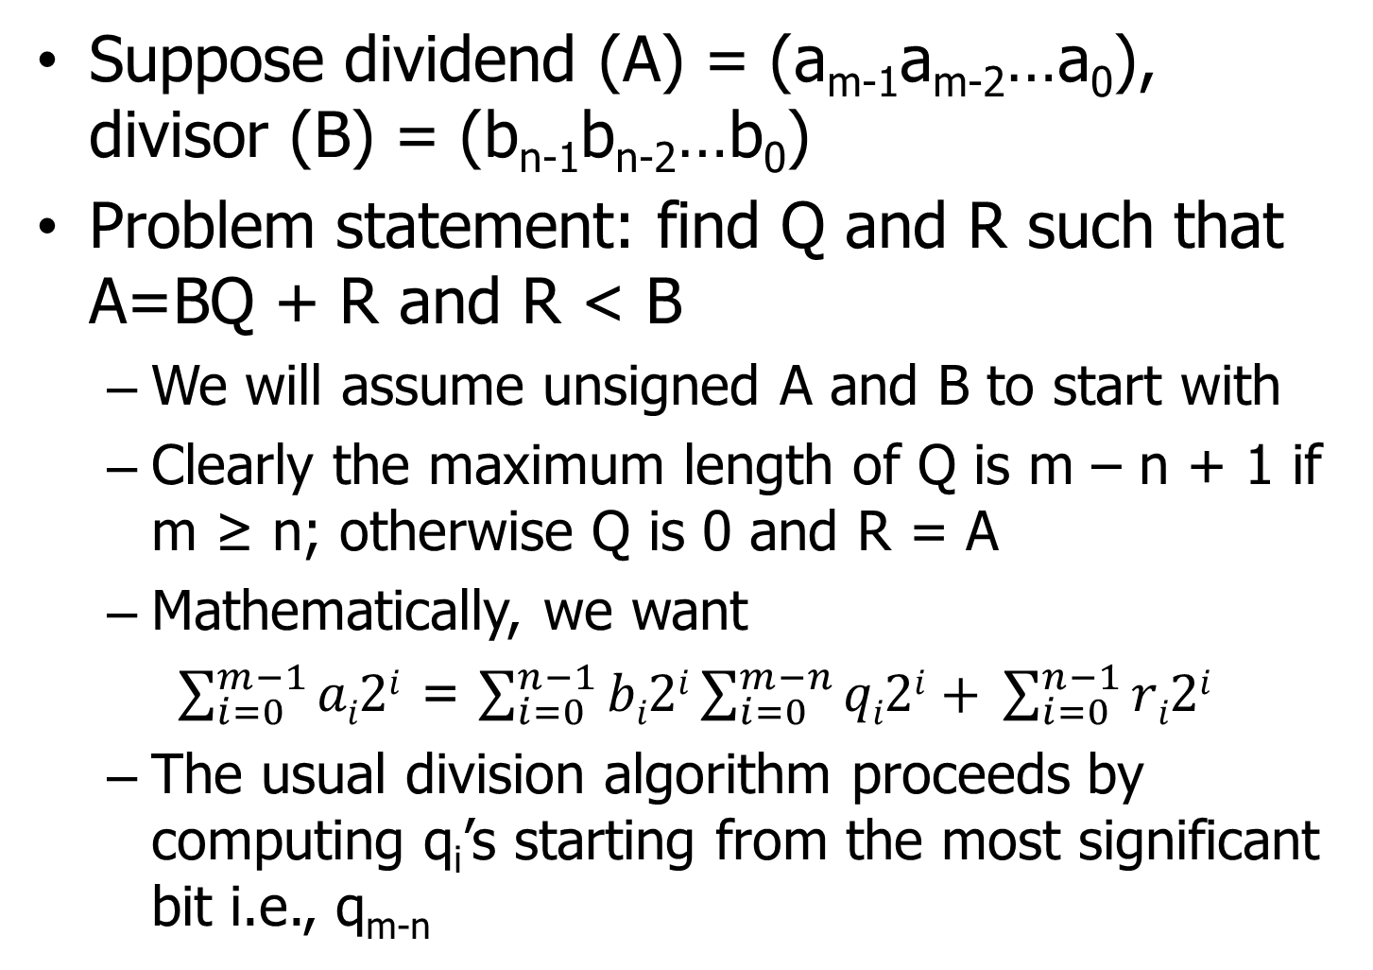
Division algorithm
Suppose dividend (A) = (a_{m-1}a_{m-2}…a₀), divisor (B) = (b_{n-1}b_{n-2}…b₀)
Problem statement: find Q and R such that A=BQ + R and R < B
We will assume unsigned A and B to start with
Clearly the maximum length of Q is m – n + 1 if m ≥ n; otherwise Q is 0 and R = A
Mathematically, we want
$\sum_{i=0}^{m−1}{ai2i}$ = $\sum_{i=0}^{n−1}{bi2i\sum_{i=0}^{m−n}{qi2i+ }}\sum_{i=0}^{n−1}{ri2i}$
The usual division algorithm proceeds by computing q_{i}’s starting from the most significant bit i.e., q_{m-n}

Slide 26
Division algorithm
Steps in usual division algorithm
1. Place A above B such that their most significant bits are aligned
This may require shifting B to the left by m – n positions (equivalent to multiplying B by 2^{m-n})
E.g., suppose A = 1001010, B = 1000 (m=7, n=4)
A = 1001010
B’ = 1000000 (shifted B)
2a. If B’ is less than or equal to A, subtract B’ from A and assign Q = (Q << 1) | 1, A = the result of subtraction, B’ = B’ >> 1 (to compute next lower q_{i}; notice the similarity with polynomial division)
2b. If B’ > A, shift B’ to the right by one bit position and assign Q = (Q << 1) [Q gets a 0 bit]
Repeat step 2a or 2b m – n + 1 times, each time producing one bit of Q; R is residual A at the end

Slide 27
Division algorithm
Execution of the usual algorithm (iteration 1)
A = 1001010 Q = 0
B’ = 1000000
--------------------
0001010 ← new A Q = 1
0100000 ← new B’

Slide 28
Division algorithm
Execution of the usual algorithm (iteration 2)
A = 0001010 Q = 1
B’ = 0100000
--------------------
No subtraction
0001010 ← A Q = 10
0010000 ← new B’

Slide 29
Division algorithm
Execution of the usual algorithm (iteration 3)
A = 0001010 Q = 10
B’ = 0010000
--------------------
No subtraction
0001010 ← A Q = 100
0001000 ← new B’

Slide 30
Division algorithm
Execution of the usual algorithm (iteration 4)
A = 0001010 Q = 100
B’ = 0001000
--------------------
0000010 ← new A Q = 1001
0000100 ← new B’
Done executing four iterations (m – n + 1 iterations)
Quotient is 1001 and remainder is residual A i.e., 10
Each iteration computes one coefficient q_{i} (either 0 or 1) of the polynomial q_{i}2^{i} by equating the leading powers of residual A and B

Slide 31
Division algorithm
The first step of aligning the divisor and dividend is important for the main division algorithm to work correctly
In a processor, A and B will be in two 32-bit registers to begin with
The first step requires computing m – n and shifting B to the left by m – n bits
How to compute m and n quickly from A and B?
This is essentially a search problem that searches for the most significant non-zero bit in a given binary string

Slide 32
Division algorithm
Divisor ← Divisor << (m – n)
Y
Remainder ≥ Divisor ?
N
N
Remainder ← Remainder – Divisor
Iteration == m – n + 1 ?
Y
Quotient ← (Quotient << 1) | 1
Quotient ← Quotient << 1
STOP
Divisor ← Divisor >> 1
Initial:
Remainder ← Dividend
Quotient ← 0
Iteration++

Slide 33
Division algorithm
Critical path of one iteration involves a comparison and a subtraction
Left shift and OR, right shift, increment can all be done in parallel with subtraction
A variant of this algorithm always subtracts, then checks if the remainder is negative and if yes, restores the remainder
Known as restoring division algorithm
Checking if remainder is negative requires comparing only the most significant bit
Critical path now involves a subtraction, a negative check, and an addition

Slide 34
Restoring division algorithm
Divisor ← Divisor << (m – n)
Remainder ← Remainder – Divisor
N
Y
Remainder < 0 ?
Iteration == m – n + 1 ?
N
Y
Remainder ← Remainder + Divisor
Quotient ← (Quotient << 1) | 1
STOP
Quotient ← Quotient << 1
Divisor ← Divisor >> 1
Initial:
Remainder ← Dividend
Quotient ← 0
Iteration++

Slide 35
Non-performing restoring division
Divisor ← Divisor << (m – n)
Lot less number of
arithmetic ops ☺
Temp ← Remainder
Two copy ops,
a subtraction,
a sign bit check
on critical path ☹
Remainder ← Remainder – Divisor
N
Iteration == m – n + 1 ?
Y
Y
Remainder < 0 ?
N
Remainder ← Temp
STOP
Quotient ← (Quotient << 1) | 1
Quotient ← Quotient << 1
Divisor ← Divisor >> 1
Initial:
Remainder ← Dividend
Quotient ← 0
Iteration++

Slide 36
Non-restoring division algorithm
Remainder ← Remainder + Divisor
Divisor ← Divisor << (m – n)
Y
Remainder < 0 ?
N
N
Remainder ← Remainder – Divisor
Iteration == m – n + 1 ?
Y
Quotient ← Quotient XOR 0x1
Quotient ← (Quotient << 1) | 1
STOP
One extra step at end may be needed if Remainder is still negative
Divisor ← Divisor >> 1
Initial:
Remainder ← Dividend
Quotient ← 0
Iteration++

Slide 37
Non-restoring division algorithm
Why is this correct?
Suppose in iteration#k of restoring division, r – d turns out to be negative, so we restore r
In iteration#k+1 of restoring division, we compute r – d/2 (note that d is shifted right)
In non-restoring division’s iteration#k, we keep r – d (which is negative) and in iteration#k+1, we do r – d + d/2 yielding r – d/2, which is same as the value of the remainder in restoring division after iteration#k+1
The quotient is adjusted in iteration#k+1 by first making the last shifted bit 0 and then shifting in a 1
Critical path = sign bit check; (addition or subtraction || Quotient update || divisor shift || iteration increment) [“;” → seq., “||” → parallel]

Slide 38
Non-restoring division algorithm
Hardware implementation
Directly follows from the algorithm
It is possible to combine {remainder, quotient} in a single register of size m bits
At the beginning, the entire register is occupied by the m-bit dividend and quotient is zero
At the end, the least significant m – n bits along with the last quotient bit will be the final quotient and the remaining n bits will contain the remainder
Justifies why Lo contains quotient and Hi contains remainder in MIPS division instructions’ result
Key observation: instead of shifting the divisor to the right in each iteration, the same effect can be achieved by shifting the dividend to the left

Slide 39
Division algorithm (A shifted left)
Execution of the usual algorithm (iteration 1)
A,Q = 1001010 Q = 0
B’ = 1000000
------------------------
0001010 Q = 1
0010101 ← new A,Q

Slide 40
Division algorithm (A shifted left)
Execution of the usual algorithm (iteration 2)
A,Q = 0010101 Q = 1
B’ = 1000000
--------------------
No subtraction
0101010 ← new A,Q Q = 10

Slide 41
Division algorithm (A shifted left)
Execution of the usual algorithm (iteration 3)
A,Q = 0101010 Q = 10
B’ = 1000000
--------------------
No subtraction
1010100 ← new A,Q Q = 100

Slide 42
Division algorithm (A shifted left)
Execution of the usual algorithm (iteration 4)
A,Q = 1010100 Q = 100
B’ = 1000000
-----------------------
0010100 Q = 1001
Done executing four iterations (m – n + 1 iterations)
The remainder appears in upper 4 bits (n=4) of residual {A,Q} and quotient is the concatenation of the lower 3 bits (m – n = 3) of residual {A, Q} and the last bit of quotient
Remainder
Quotient = 1001

Slide 43
Non-restoring division algorithm
m bits
Clock inputs
Divisor << (m – n)
m-bit adder /subtractor
Add/
Sub
m-bit {remainder,quotient} register
XOR
<< 1
OR
MSB
1
Iteration count register
+1
m – n + 1
!= ?
AND
clk

Slide 44
Signed division
Suppose A and B are positive and we have A = BQ + R
So, -A = -BQ – R is the expected result of dividing –A by B
Rule: remainder must have the same sign as the dividend

Slide 45
Signed division
Signed division algorithm
Convert the negative operand(s) to their positive value(s) and use any unsigned division algorithm
If both operands were positive originally, stop
A = BQ + R
If both operands were negative originally, negate remainder
-A = -BQ + (-R)
If dividend was negative and divisor was positive, negate both quotient and remainder
-A = B(-Q) + (-R)
If dividend was positive and divisor was negative, negate quotient
A = -B(-Q) + R

Slide 46
Signed division
MIPS has both signed and unsigned division
div instruction treats operands as signed
divu treats operands as unsigned
Faster division algorithms are non-trivial
The subtractions cannot be done in parallel
Fast algorithms try to predict quotient bits and detect and correct mispredictions on the fly

Slide 47
Floating-point addition
Assume that the operands are represented in IEEE 754 format
Step 1: Align exponents of the operands by shifting significand of the smaller number to the right (recall significand = 1.mantissa)
Step 2: Add significands
Use 2’s complement integer arithmetic ignoring the binary point
If result is negative, convert to its positive value
Put back the binary point after addition and assign the sign bit depending on the result’s sign
Step 3: Normalize the sum
Shift right and increase exponent OR shift left and decrease exponent

Slide 48
Floating-point addition
Step 4: If overflow or underflow detected, raise exception
Step 5: Round mantissa of the normalized sum to fit the precision
This may make the result unnormalized e.g., 1.11111…1 in binary becomes 10.00000…0 after half-way rounding rule is applied
If not normalized, repeat steps 3, 4, 5; else stop
Precision could be lost in intermediate computations e.g., during shifting significand
To avoid this, IEEE 754 standard recommends use of three additional bits in intermediate representations (guard bit, round bit, sticky bit)

Slide 49
Use of guard, round, sticky bits
The guard and round bits extend the mantissa by two bits
The sticky bit appears after the round bit and is set to 1 if any bit to the right of the round bit is 1
These bits improve the precision of arithmetic whenever the significand needs to be shifted to the right
These bits retain a few mantissa bits which would otherwise get dropped
If the normalization step needs to shift the significand to the left, these bits will start contributing to the precision of the mantissa

Slide 50
Floating-point addition
Example: 0.5 + (-0.4375)
0.5 = 1.000 x 2⁻¹, -0.4375 = -1.110 x 2⁻²
Step 1: Align exponents
-1.110 x 2⁻² = -0.111 x 2⁻¹
Step 2: Add significands
1.000 + (-0.111)
1000 + 1001 = 0001 (2’ complement)
0.001 after putting back the binary point
Step 3: Normalize
0.001 x 2⁻¹ = 1.000 x 2⁻⁴ = 0.0625
No overflow or underflow because exponent is within legitimate range; no need to round also

Slide 51
Floating-point multiplication
Step 1: Add the biased exponents of the operands and subtract the bias to get the new biased exponent
Step 2: Multiply significands
Use unsigned integer multiplication algorithm ignoring the binary point
Put the binary point after N bit positions from right where N is the sum of the lengths of the mantissa of two operands
Step 3: Normalize the product
Step 4: If overflow or underflow detected, raise exception
Step 5: Round the product; if product is not normalized, repeat steps 3, 4, 5

Slide 52
Floating-point multiplication
Step 6: If the signs of the operands are same, the product is assigned positive sign; otherwise the product is negative
Example: 0.5 x (-0.4375)
(1.000 x 2⁻¹) x (-1.110 x 2⁻²)
New biased exponent = (127 – 1) + (127 – 2) – 127 = 124 = (127 – 3)
Actual exponent -3
Multiply significands: 1000 x 1110 = 1110000
Put back binary point: 1.110000
Unsigned product = 1.110 x 2⁻³
Already normalized and no overflow
No need to round
Final product = -1.110 x 2⁻³ = -0.21875

